Slide 1
SpectrePlex Heater V2.0

Slide 2
Background
Current system has regulation issues. It’s a PTC heater and self regulates, but has a set point of 60C and that cant be altered. It also cant generate enough heat. It tops out at about 12W and I suspect that I need more around 20W.
For kinetics I need temp regulation and to alter the temp. The PTC is incapable of that.
I think a new style of temp probe and poly heater can do the job.

Slide 3
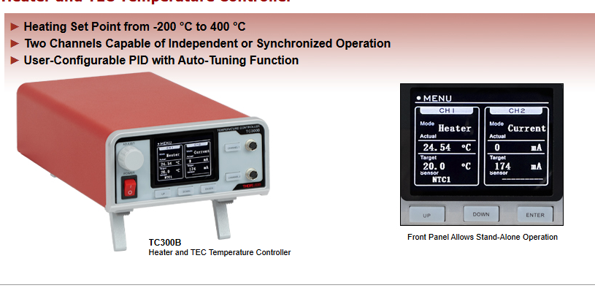
Proposed Controller
https://www.thorlabs.com/newgrouppage9.cfm?objectgroup_id=14852

Slide 4
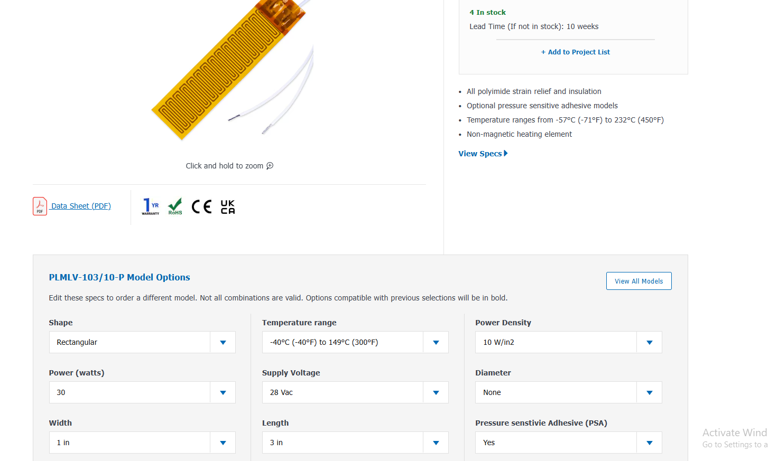
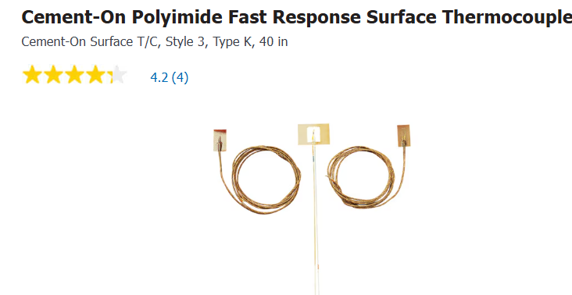
Heater/ Temp Sensor
https://www.omega.com/en-us/industrial-heaters/surface-heaters/flexible-heaters/plm-series/p/PLMLV-103-10-P
Give 30W and both are thin. Accept roughly the output voltage from the thor labs.

